Slide 1

INFOTACT SOLUTIONS
BCA Final Project Review
INTERNSHIP PROJECT PRESENTATION • 5 SEPT 2026 – 5 OCT 2026
AtmoSync: Micro-Climate Arbitrage Analytics
Comprehensive Weather Data Generation, EDA, and Power BI Visualization Pipeline
TEAM LEADER
TEAM MEMBERS
Janhavi Raut
Ravinder Singh • Soumik Singha Mahapatra • S. Priyanka
Status: Completed

Slide 2


SECTION 01 • INTRODUCTION
What is Micro-Climate Data Analysis?
Understanding Micro-Climates
Purpose of AtmoSync
A micro-climate is the climate of a small, specific restricted area—such as a shipping container, greenhouse, or storage unit—that differs from the surrounding general climate.
AtmoSync processes structured weather datasets to simulate, clean, and analyze environmental conditions across 100 isolated containers, enabling clear visibility into temperature and humidity patterns.
AtmoSync Final Project Review • Infotact Solutions
Slide 2

Slide 3
SECTION 02 • PROBLEM STATEMENT
Why Analyze Temperature, Humidity & Location?
Perishable Spoilage Risks
Need for Systematic Insight
Geographic Context
Unmonitored climate variations lead to cargo spoilage, agricultural losses, and reduced product shelf-life.
Organizations need structured analytics to classify environmental conditions and detect thermal anomalies.
Mapping container locations (latitude/longitude) helps correlate geographical regions with specific temperature profiles.
AtmoSync Final Project Review • Infotact Solutions
Slide 3

Slide 4
SECTION 03 • OBJECTIVES
Core Project Objectives
1
Data Extraction & Generation
2
Data Cleaning & Validation
Process source weather data into a clean, container-wise dataset with 5,000 records.
Remove nulls, handle missing values, and validate schema integrity using Python.
3
Exploratory Data Analysis (EDA)
4
Interactive Dashboard Visualization
Calculate statistical summaries, correlations, and climate type distributions.
Build a professional Microsoft Power BI dashboard for dynamic reporting and exploration.
AtmoSync Final Project Review • Infotact Solutions
Slide 4

Slide 5
SECTION 04 • DATASET STRUCTURE
Source & Final Dataset Specifications
Source Dataset
Final Dataset
GlobalWeatherRepository.csv — Provided raw weather parameters, meteorological indexes, and regional geographic coordinates.
AtmoSync_Final_Data.csv — Specifically structured with 5,000 records across 100 containers and 6 core columns.
Total Records: 5,000
Total Containers: 100 Units
Columns: 6 Fields
AtmoSync Final Project Review • Infotact Solutions
Slide 5

Slide 6
SECTION 05 • TECH STACK
Tools & Technologies Used
Python
Pandas & NumPy
Matplotlib
Core programming language for data generation and logic.
Data cleaning, manipulation, and statistical computations.
Exploratory data visualization and pattern plotting.
Jupyter Notebook
Microsoft Power BI
GitHub
Interactive development environment for code execution.
Interactive dashboard design and KPI reporting.
Version control, repository management, and collaboration.
AtmoSync Final Project Review • Infotact Solutions
Slide 6

Slide 7
SECTION 06 • PIPELINE ARCHITECTURE
End-to-End Project Workflow
1. Source Dataset
2. Selection & Prep
3. Data Generation
4. Validation
GlobalWeatherRepository.csv
Schema and field mapping
5,000 rows across 100 units
Null checks and cleaning
5. Data Analysis (EDA)
6. Power BI Dashboard
Statistical summary & correlation (-0.47)
Interactive KPI & visualization reporting
AtmoSync Final Project Review • Infotact Solutions
Slide 7

Slide 8
SECTION 07 • DATA PREPARATION
Data Generation & Preparation Details
Container-Wise Organization
Important Distinction
Weather records were mapped across 100 distinct containers to simulate isolated environmental pods with designated timestamps and geographic coordinates.
The timestamps used in this project are generated timestamps derived from prepared historical weather records—not live real-time IoT sensor readings.
AtmoSync Final Project Review • Infotact Solutions
Slide 8

Slide 9
SECTION 08 • EDA FINDINGS
Exploratory Data Analysis (EDA) Summary
AVERAGE TEMPERATURE
MINIMUM TEMPERATURE
MAXIMUM TEMPERATURE
26.37°C
-3.7°C
49.1°C
AVERAGE HUMIDITY
MIN / MAX HUMIDITY
TEMP-HUMIDITY CORRELATION
55.01%
3% – 100%
-0.47
AtmoSync Final Project Review • Infotact Solutions
Slide 9

Slide 10


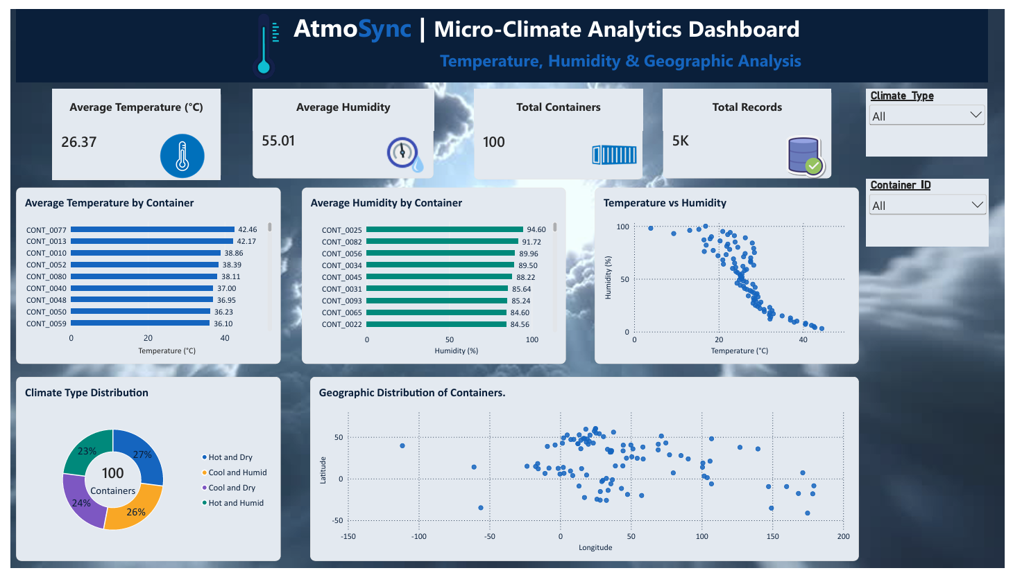
SECTION 09 • VISUALIZATION
Microsoft Power BI Dashboard
Interactive report featuring KPIs, distribution charts, and geographic scatter plot.
AtmoSync Final Project Review • Infotact Solutions
Slide 10

Slide 11
SECTION 10 • ANALYTICAL INSIGHTS
Key Findings & Insights
Temperature-Humidity Relationship
Climate Category Distribution
The correlation coefficient of -0.47 indicates a moderate negative relationship in this dataset—meaning as container temperature increases, relative humidity tends to decrease. (Note: This reflects correlation, not direct causation.)
Containers were segmented into four balanced quadrants relative to overall dataset averages: Hot & Dry (27%), Cool & Humid (26%), Cool & Dry (24%), and Hot & Humid (23%).
AtmoSync Final Project Review • Infotact Solutions
Slide 11

Slide 12
SECTION 11 • SCOPE & BOUNDARIES
Challenges & Limitations
Historical vs. Live Data
Economic Arbitrage Scope
Geographic Visualization
This project is an analysis of prepared historical weather records and simulated container timestamps, not a live IoT sensor deployment.
The project focuses on environmental classification and statistical patterns—it does not directly calculate actual transport costs, selling prices, or financial arbitrage profits.
Geographic coordinates are represented via a longitude-versus-latitude scatter plot rather than a fully interactive geospatial map overlay.
AtmoSync Final Project Review • Infotact Solutions
Slide 12

Slide 13
SECTION 12 • SUMMARY & FUTURE SCOPE
Conclusion & Future Scope
Project Achievements
Future Scope (Proposed)
Successfully processed 5,000 records across 100 containers, executed rigorous EDA in Python, and built a comprehensive Microsoft Power BI dashboard at Infotact Solutions.
Future improvements may include real-time IoT sensor integration, automated data pipelines, predictive weather forecasting models, and economic cost-optimization algorithms.
AtmoSync Final Project Review • Infotact Solutions
Slide 13

Slide 14


Thank You!
Questions & Viva Discussion
AtmoSync: Micro-Climate Arbitrage Analytics • Infotact Solutions

